Slide 1
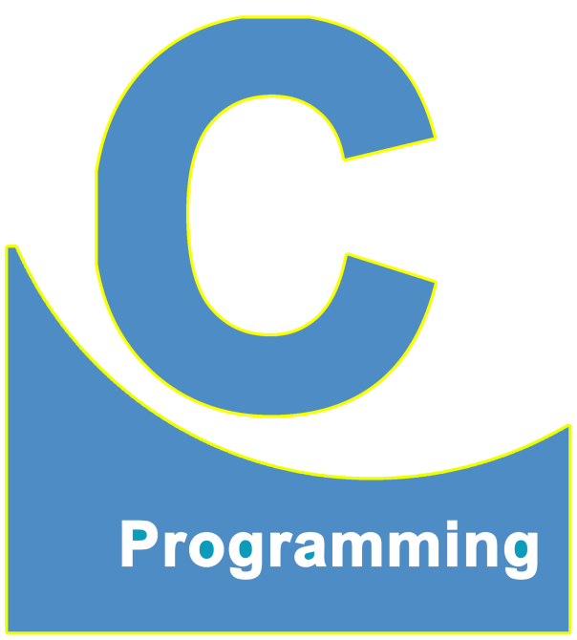
01
02
C Language
Lecture 31
04

Slide 2


Today’s Agenda
01
Pointers
02
Some Example

Slide 3
Pointer
Predict the scenarios happen on RAM on the execution of the following lines of codes
int main()
{
int a = 10;
printf("Value of a is %d", a);
printf("\nAddress of a is %u", &a);
return 0;
}
RAM
Output: 10
10
a
(1000)
Assume address of variable a is
1000
Output: 1000
As we have discussed earlier the address of the variable in Turbo ranges from
(0 to 65535) so we use %u

Slide 4


Pointer
Now suppose we have to store the address of variable a into another variable let say
Variable b
int main()
{
int a = 10;
int b;
unsigned int c;
b = a;
c = &a;
return 0;
}
RAM
We use unsigned int to store
address who ranges from
(0 to 65535)
10
a
(1000)
Why it is
Still giving
ERROR
Assume address of variable a is
1000

Slide 5
Reason behind this behavior
Although addresses are looks like as normal numbers but for compiler they have special meaning
Because a normal variable can hold only value, it can not holds the addresses of the other variables
So to store these special numbers we have to declare a special variable which are able to store addresses of other variable in it and for this purpose the topic which we are studying will be used which is the pointer

Slide 6
What is a pointer?
A pointer in C language is a VERY SPECIAL variable that can store ADDRESS of other variables.
For Application of the pointer please wait for the end of the topic
As the topics goes on you came to know why the pointer is so important in C and why it is also known as the backbone of the C language
How do we declare a pointer?
Syntax:
<data_type> * <pointer_variable_name>;

Slide 7
IMPORTANT POINTS of POINTERS
The data type of a pointer is always decided by looking at the data type of the variable whose
address the compiler/the programmer will store inside the pointer
So if a variable is of type int, then the pointer will also be of type int, if the variable is of type
char, then the pointer will also be of type char
int main()
{
int a = 10;
int *p;
p = &a;
printf("Address of a is %u", &a);
printf("\nContents of p is %u", p);
return 0;
}
RAM
10
a
(1000)
Output: 1000
Assume address of pointer p is 4000
4 Bytes
In GCC
Output: 1000
2 Bytes
In Turbo
1000
p
(4000)

Slide 8
Important points about pointer
Type of the pointer should be the same as the type of the variable
The size of the pointer does not depend on the type the size of the pointer is always 2 Bytes for
Turbo and is off 4 Bytes for GCC Compiler
int main()
{
int a = 10;
int *p;
p = &a;
printf("Address of a is %u", &a);
printf("\nContents of p is %u", p);
printf("\n%d %d", a, *p);
return 0;
}
RAM
10
Output: 1000
a
(1000)
Assume address of pointer p is 4000
Output: 1000
4 Bytes
In GCC
2 Bytes
In Turbo
1000
p
(4000)
Output: 10 10

Slide 9
Pronunciation of *p
1. Value at the address stored in p
RAM
*p
10
a
(1000)
Value at
address stored in p
*(1000)
1000
Can also be pronounced as Value at p
p
(4000)
10

Slide 10
Pronunciation of int *p;
p is a pointer to an integer
Do not pronounce it as
Integer star p
RAM
10
int
*p;
a
(1000)
Right - Left
1000
p
(4000)

Slide 11
Remember
*p can’t be pronounced as
Star p
Asterisk p
Pointer p
*p
Value at
address stored in p
or
Value at
p
Address of operator
Indirection Operator
&
*

Slide 12
Pronunciation of *p
10
Value at
address stored in p
printf(“%d”, *p);
RAM
10
a
(1000)
Dereferencing
Indirect Addressing
1000
p
(4000)

Slide 13
Dereferencing
RAM
Fetching variable value using it’s reference(address)
10
a
(1000)
Address
De
reference
ing
Reference
1000
Address
p
(4000)

Slide 14
Referencing/Dereferencing
int main()
{
int a = 10;
int *p;
printf("Address of a is %u", &a);
printf("\nContents of p is %u", p);
printf("\n%d %d", a, );
}
Because we are assigning address of a in pointer p
Referencing
p = &a;
Dereferencing of a Pointer
*p
Because we are Fetching value of variable a using pointer p

Slide 15
Direct/Indirect Addressing
printf(“%d”, );
printf(“%d”, );
a
Direct Addressing
Output: 10
*p
Indirect Addressing
Output: 10

Slide 16
Predict the output of the following code
int main()
{
int a = 10;
int *p;
p = &a;
printf("Address of a is %u", &a);
printf("\nContents of p is %u", p);
printf("\n%d %d", a, *p);
a = 20;
printf("\n%d %d", a, *p);
return 0;
}
RAM
10 20
a
(1000)
Assume address of pointer p is 4000
Output: 20
4 Bytes
In GCC
2 Bytes
In Turbo
1000
p
(4000)
Output: 20

Slide 17
Predict the output of the following code
int main()
{
int a = 10;
int *p;
p = &a;
printf("Address of a is %u", &a);
printf("\nContents of p is %u", p);
printf("\n%d %d", a, *p);
a = 20;
printf("\n%d %d", a, *p);
*p = 30;
printf("\n%d %d", a, *p);
return 0;
}
Using pointer we can not only access a variable's value but we also can change/modify the variable's value
RAM
10 20 30
a
(1000)
Output: 20
Assume address of pointer p is 4000
4 Bytes
In GCC
Output: 20
Output: 30
2 Bytes
In Turbo
1000
p
(4000)
Output: 30

Slide 18
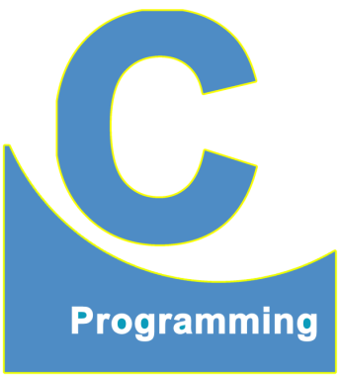
End of Lecture 31
For any queries mail us @: scalive4u@gmail.com
Call us @ : 0755-4271659, 7879165533
Thank you

